Slide 1
Macroeconomic Modeling with Distributional Considerations: An Introduction
Vivian Malta, IMF
IMF Flickr

Slide 2
Revisiting Microdata
Detailed info about individual people or entities such as households, business enterprises, farms, geographical areas, etc.
Granularity enables in-depth analysis and customized insights.
Each household income vs. average income in a country
Supports the creation of data-driven policies based on observed patterns.
Unit-level data obtained from surveys, censuses, and administrative systems.
Household Income and Expenditure Surveys (HIES)
Labor Force Surveys (LFS)
Demographic and Health Surveys (DHS)
Enterprise or Business Surveys
Notes:
Labour force surveys are one of the primary national household surveys conducted by countries. They are designed with the objective to produce official national statistics on the labour force, employment and unemployment for monitoring and planning purposes. LFS are the main source behind headline indicators of the labour market for short-term monitoring as well as more structural information on the number and characteristics of the employed, their jobs and working conditions, the job search activities of those without work, etc. They are a unique source of data on informal employment, and increasingly designed to produce statistics on unpaid forms of work and other related topics through add-on modules.

Slide 3
Wage Gap Decompositions

Slide 4
Wage Gap Decompositions
Wages often differ by groups: young vs old, men vs women, etc.
Here we will apply the wage gap decomposition for male vs female.
The overall gender wage gap is the difference between average female and male total earnings from labor
This gap can reflect different work conditions and job characteristics between men and women, related for example to the number of hours worked or the skills required for the job.
However, it can also reflect discrimination—a wage premium for one group of workers that cannot be explained by controlling for observable individual and job characteristics.
We can estimate both explained and unexplained using the Blinder-Oaxaca decomposition.
We control for observable characteristics: workers’ age, education, sector of activity, location, occupation, etc.
We use household survey data (micro data) for this analysis

Slide 5

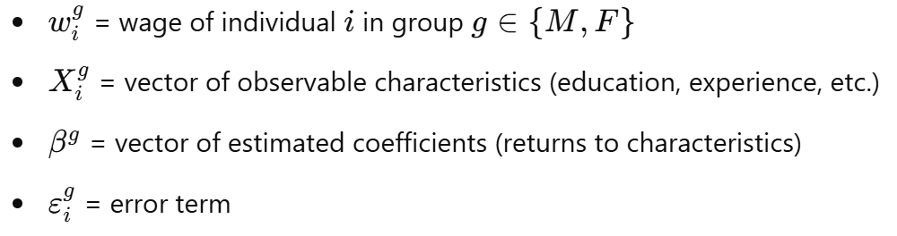
Oaxaca-Blinder Decomposition
Objective: to decompose the average wage difference between two groups, here: men (M) and women (F) into:
An explained component: due to differences in characteristics (like education, experience).
An unexplained component: due to differences in returns to those characteristics (often interpreted as discrimination or structural factors).
Model: assume a standard log-linear wage regression for each group:

Slide 6

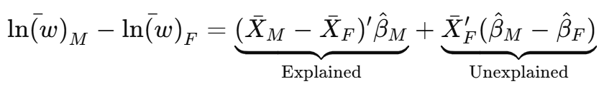
Oaxaca-Blinder Decomposition
Explained part: Wage gap due to differences in characteristics (e.g. if men have more education or experience).
Unexplained part: Wage gap due to differences in returns to characteristics (e.g. same level of education for both men and women, but men earning higher wages), often interpreted as discrimination.
Software packages calculate this directly.

Slide 7
Example: Senegal (2018 IMF Article IV)
Total wage gap of 47%
Observables (“X”): education, experience, sector, type of activity, sector, type of contract, localization, gender, ethnicity, age.
1/3 of the gender wage gap is explained: e.g. by less education, less formal jobs
2/3 is unexplained (differences in the estimated parameters): women have lower returns from experience than men; women start from a lower pay level (much inferior and statistically significant regression intercept on women’s wage equation)

Slide 8
Example: Malawi
Paper from Van den Broeck et al. 2023 explores gender pay gap in non-farm employment
Sectors are manufacturing, construction, commerce, etc
Rural Malawi: Gender Pay Gap: 36% (statistically significant)
Explained (Endowment) Component: 81% (education, sector, and occupation)
Unexplained (Structural) Component: 19%
Urban Malawi: Gender Pay Gap: 38% (statistically significant)
Explained Component: 49%
Unexplained Component: 51% -- potentially reflects discrimination

Slide 9
Example: Malawi
Sectoral segregation contributes substantially to the gender wage gap, especially in urban areas.
In rural Malawi, occupational segregation (i.e., men in better-paying wage jobs, women in lower-paying self-employment) is the largest driver of the explained component.
Addressing gaps in education and giving women access to better-paying occupations/sectors can help narrow the wage gap.

Slide 10
Macroeconomics heterogeneous agents’ model with gender considerations

Slide 11
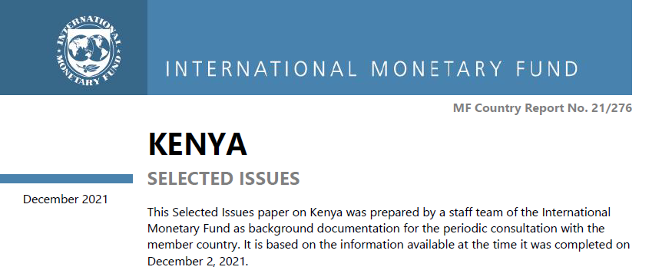
General equilibrium model using Kenya’s 2015-16 Household Survey, as well as macro data
(new data 2024-25-Kenya-Integrated-Household-Budget-Survey-Pilot-Report.pdf)
The model can be used to quantify the impacts of policies on:
Economic growth and aggregates
Distributional levels of income
Gaps and FLFP
Across Generations

Slide 12
The model
A micro-founded overlapping generations model featuring:
Heterogeneous households (age; formal and informal; men and women; income shocks)
Productive sectors (formal vs informal)
In this framework, women face different barriers to human capital development, economic participation over the life-cycle:
Early education
Disutility cost from women working (including unpaid work)
Discrimination in the labor market (formal and informal)
Go to Working Paper

Slide 13
Kenya example: parametrization
Years of education by gender and income level:
Other parameters: returns from education and from experience (in different age groups), average income tax rate paid by each percentile of income distribution

Slide 14
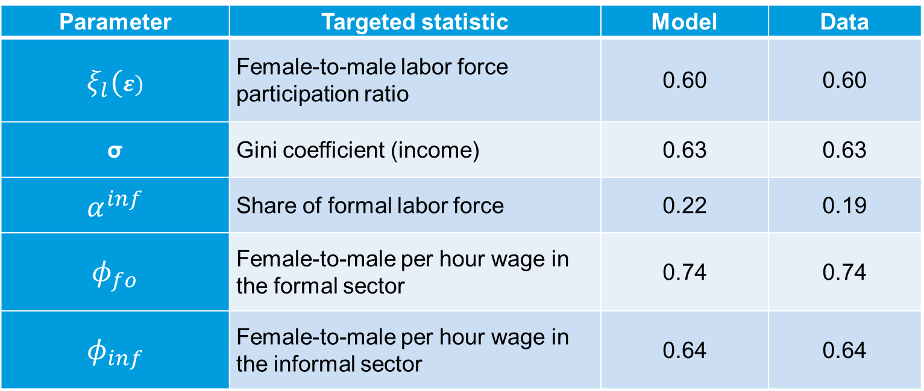
Kenya example: parametrization examples using micro data
Parameter | Targeted statistic | Model | Data
$$ξ_{l}(ε)$$ | Female-to-male labor force participation ratio | 0.60 | 0.60
σ | Gini coefficient (income) | 0.63 | 0.63
$$α^{inf}$$ | Share of formal labor force | 0.22 | 0.19
$$φ_{fo}$$ | Female-to-male per hour wage in the formal sector | 0.74 | 0.74
$$φ_{inf}$$ | Female-to-male per hour wage in the informal sector | 0.64 | 0.64

Slide 15
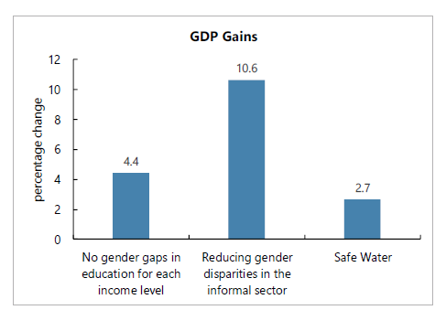
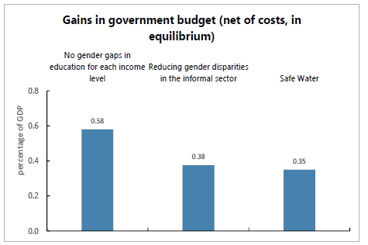
Gains from reducing gender gaps and providing safe piped water
Recalibrating production functions!

Slide 16
Analyzing macroeconomic and distributional effects of Artificial Intelligence

Slide 17
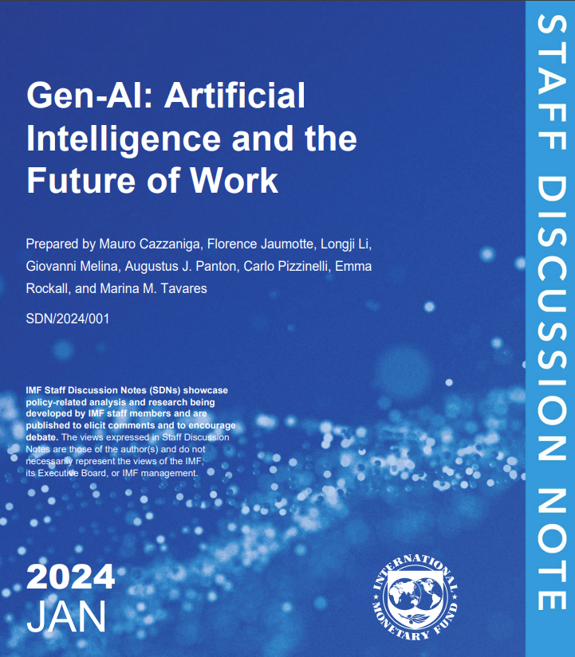
This IMF Staff Discussion Note used micro-level labor data to understand the impact of Gen-AI

Slide 18
Using micro-data
IMF staff looked at hundreds of individual tasks to predict the future of the whole economy: Task-level information for about 1,000 occupations from the Occupational Information Network.
The Micro-Data Advantage: By using detailed job surveys and labor data, they could see exactly which parts of a job a computer can do and which parts still need a human touch.
Why this matters for Macroeconomics: This "bottom-up" data allows the IMF to predict big trends—like national growth and total employment—with much higher accuracy than just looking at past structural changes.

Slide 19
More on the micro-data
O*NET doesn't just collect job titles; it maps things like:
Work Activities: General types of job behaviors (e.g., analyzing data, interacting with computers).
Abilities/Skills: Permanent or acquired attributes (e.g., Inductive Reasoning, Active Listening).
Measurement Metrics: Every task/descriptor is measured on two standardized Likert scales (Surveyed from incumbents and analysts):
Importance: How critical is this task? (Scale 1–5).
Level: What degree of this skill is needed? (Scale 1–7).
How the IMF uses this: These granular scores are the inputs in the task-based general equilibrium model. When the paper says an occupation has high complementarity, it means it scored high on O*NET categories like "Critical Thinking" and "Judgment" where Gen-AI cannot yet reach the highest levels.

Slide 20
The paper’s idea: Not every job is affected by AI in the same way.
🟢 Green Light: These are jobs where AI makes the person better at what they do (think doctors or engineers). These workers see their productivity—and their pay—go up.
🟡 Yellow Light: Jobs that are physical or manual (like construction or cleaning). AI doesn't have much of an impact here yet, so these jobs stay stable.
🔴 Red Light (The "Replacement" Risk): Jobs involving routine office work or data entry. Here, AI might actually take over the tasks, putting these workers' income at risk.

Slide 21
Implications for wealth distribution
AI tends to help people who are already high earners. Because high-paying jobs often involve "Green Light" tasks, the rich may get richer, while the middle class faces more competition.
Owners vs. Workers: A major macroeconomic concern is that more of a country’s income will go to the people who own the AI software (capital) rather than the people working the jobs (labor).
The Gender & Age Gap: Because women and younger workers are often in roles with high AI exposure, they may feel the "shake-up" in the labor market more intensely and more quickly.

Slide 22
AI Preparedness Index
The IMF used the model's results to create the AI Preparedness Index (AIPI), which measures how ready a country is for this shift. The answers change based on four pillars:
Digital Infrastructure: Do people have the internet and electricity to even use AI?
Human Capital: Does the workforce have the education to transition into "Green Light" (complementary) jobs?
Innovation & Regulation: Are there laws to protect workers and encourage new businesses?
Social Safety Nets: Is the country’s fiscal policy strong enough to support workers during the "shake-up"?
The Takeaway: For advanced economies, the risk is immediate labor disruption. For developing economies, the risk is being "left behind" because they lack the infrastructure to capture the productivity gains.

Slide 23
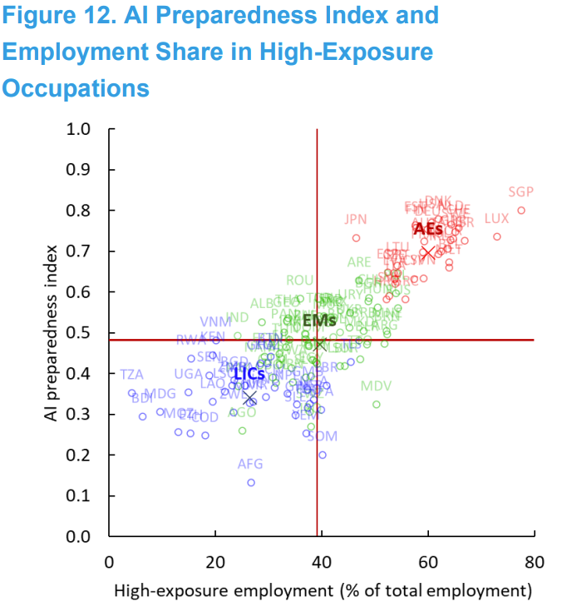
AI Preparedness Index
Notes:
Sources: Fraser Institute; International Labour Organization; International Telecommunication Union; United Nations; Universal Postal Union; World Bank; World Economic Forum; and IMF staff calculations. Note: The plot comprises 125 countries: 32 AEs, 56 EMs, and 37 LICs. The red reference lines are derived from the median values of the AI Preparedness Index and high-exposure employment. Exes denote the average values for each corresponding country group. Circles represent the average values for each respective country group. AEs = advanced economies; EMs = emerging market economies; LICs = low-income countries. Country labels use International Organization for Standardization (ISO) country codes

Slide 24
Using Heterogeneous Agents Models
The model tracks individuals based on their wealth, skills, and how easily they can switch jobs if AI takes their current role.
The Micro-to-Macro Bridge: By mapping these hundreds of tasks onto millions of real-world households, the model can predict how a change in a small task (micro) alters the entire nation's GDP (macro). The model answers questions like:
If we give every worker an "AI Co-pilot," how much faster will the economy grow?
If AI mainly helps people who already have high-paying cognitive jobs, how much wider will the gap between the rich and the poor grow?
Will income shift away from workers' paychecks (Labor Share) and toward the people who own the AI companies (Capital Share)?
What happens if the government uses taxes from AI gains to fund retraining programs? Can we "offset" the negative impacts?

Slide 25
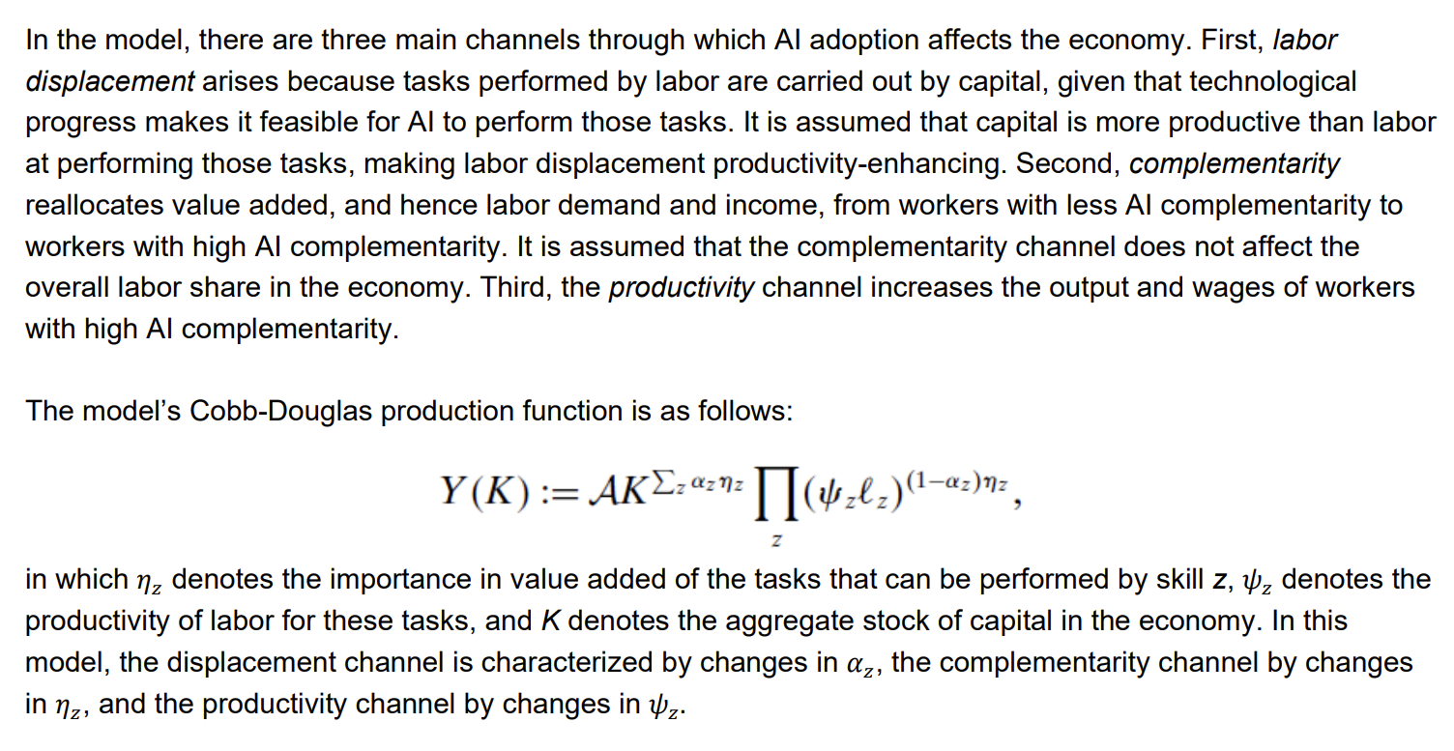
Using Heterogeneous Agents Models

Slide 26
How governments can use this data to inform policies:
Since we can see the "Red Light" areas coming, the IMF suggests three main policy "shock absorbers":
Smart Safety Nets: Modernizing unemployment insurance so it’s easier for people to get help while they switch careers.
Lifelong Learning: Moving away from "one-and-done" education. Governments need to help workers retrain specifically for "Green Light" (AI-complementary) roles.
Closing the Global Divide: Making sure developing nations have the digital infrastructure to use AI. Without it, the gap between wealthy and developing countries could grow even wider.

Slide 27
Policy for LICs
Closing the Digital Infrastructure Gap: The model shows that AI productivity gains are zero if the "complementarity" threshold isn't met.
Stable electricity and affordable high-speed broadband (prevent rural areas from being left behind)
Integrate digital literacy into basic education while subsidizing lifelong learning programs for workers who face the highest displacement risk (e.g. clerical workers).
Leveraging AI for Development: Use AI as a tool to bypass traditional bottlenecks (e.g., AI-driven microcredit scoring for the informal sector or ag-tech for smallholder farmers).

Slide 28
Thank you! Get in touch: vmalta@imf.org

